Slide 1
Developing distributed protocols formally with Ivy
Ken McMillan
Microsoft Research
Joint work with: Marcelo Taube, Giuliano Losa, Oded Padon, Mooly Sagiv, Sharon Shoham, James R. Wilcox, Doug Woos

Slide 2
Motivation
How effective is the use of automation in proofs of distributed systems?
from: Ferraiulo, Baumann, Hawblitzel, Parno, “Komodo: Using Verification to Disentangle Secure-enclave Hardware from Software”, SOSP ‘17.
“
The most frustrating recurring problem was proof instability
Timeouts are challenging to debug, because the solver generally fails to provide useful feedback
…even once fixed, the proof may easily timeout again due to minor perturbations. Worse, minor changes can trigger timeouts in seemingly unrelated proofs.
”
The deductive power of automated provers is not translating into verification productivity.

Slide 3
Diagnosis
For automation to be effective in large proofs, we need it to have the following properties:
Predictability
We can reduce proofs to automated lemmas because we can reasonably predict solver performance
Stability (or continuity)
Small, irrevelant changes do not greatly impact solver performance
Transparency
Failures have understandable explanations
I will call this collection of properties PST…

Slide 4
Ivy design goals
Ivy is a deductive verification tool for distributed systems whose goal is to make maximally productive use of the Z3 theorem prover. Its design is based on three hypotheses…
PST
productivity
decidability
PST
Ivy
tools + strategies
decidability

Slide 5
Outline
Logic and decidability
What’s decidable in Z3?
The Ivy language
Programs over first-order structures
Decidability and the fragment checker
Modular reasoning
Modularity for decidability
Abstract datatypes and theory hiding
Abstract models as lemmas
Examples
Toy leader election algorithm
Real consensus protocols

Slide 6
Logic and decidability

Slide 7
Decidable logics
Decidability means we can determine algorithmically whether a proposition is true or false.
Decidability is affected by:
Quantifier structure
Function and relation symbols
Theories (arithmetic, trees, etc.)
Logic
Decidable
Undecidable
First-order
EPR, Presburger,
QFLIA
FO, Peano
Easiest reduction
Finite-state,
propositional
Parameterized,
Infinite-state
LTL
No parameters!
Second-order
MSO,S2S
anything else
No relations!

Slide 8
First-order logic
Express predicates over a domain of discourse with:
Individual variables over the domain
Predicate and function symbols over the domain
Quantifiers over the domain
Propositional connectives
Examples:
All men are mortal: $∀x. \text{man}\left(x\right)→\text{mortal}(x)$
quantifier
predicate
connective
Every node that is not a root has a parent:
$∀x. ¬\text{root}\left(x\right)→∃y. \text{parent}(y,x)$
Function $f$ is increasing:
$∀x,y. x<y →f\left(x\right)<f(y)$

Slide 9
Semantics of FOL
A first-order structure is $M=(U,I)$, where:
The universe $U$ is a non-empty set
The interpretation $I$ is a map:
$I\left(f^{k}\right):U^{k}→U$
$I\left(p^{k}\right):U^{k}→\text{bool}$
Truth of a formula depends on a structure:
We write $M⊨φ$ when $φ$ is true in $M$
We say: “$M$is a model of $φ$”
Validity and satisfiability:
$φ$ is valid if $M⊨φ$ for all structures $M$
$φ$ is satisfiable if $M⊨φ$ for some structure $M$
A formula may be neither valid not satisfiable.

Slide 10
Theories and interpreted symbols
The theory $T$ is a set of formulas
Usually the set of $φ$ such the $M⊨φ$ for some intended structure(s) $M$.
Example: theory of the equality predicate
$∀x. x=x$, $∀x,y. x=y→y=x$, …
$∀x,y. x=y→f\left(x\right)=f\left(y\right)$, …
Models: structures where $=$ is interpreted as identity, up to FO distinguishability.
Satisfiability modulo $T$:
We write $M⊨_{T}φ$ if $M$ models both $T$ and $φ$.
An SMT solver finds a model of a formula modulo a built-in set of theories.

Slide 11
Prenex normal form
Every FO formula is equivalent to one in the form:
$Q_{1}…Q_{k}. φ$ where$Q_{i}$ is a quantifier and $φ$ unquantified
Rules for converting to PNF:
$¬∀x. φ ≡ ∃x. ¬φ$
$φ∧∀x. ψ ≡ ∀x(φ∧ψ)$ [$x$ not free in $φ$]
$\left(∀x. φ\right)→ψ ≡ ∃x.(φ→ψ)$ [$x$ not free in $ψ$] …
Example:
$∀x.\left(∃y.r\left(x,y\right)\right)→p\left(x\right) ≡ ∀x,y. r\left(x,y\right)→p(x)$
Generally speaking:
Pulling a quantifier out of a negation flips its type
The left-to-right order of quantifiers is preserved.

Slide 12
Skolem normal form
Convert every $∃$ in PNF to a fresh function symbol
Example: $∀x. ∃y. p(x,y)$ becomes $∀x. p(x,f\left(x\right))$
Every $∃$ becomes function of $∀$’s to the left
This transformation preserves satisfiability
If $φ$ has a model iff SNF of $φ$ has a model

Slide 13
Proving theorems with SMT
Suppose we want to prove that $φ$ is valid
We try to show that $¬φ$ is unsatisfiable:
Negate $φ$
Convert $¬φ$ to prenex normal form
Skolemize
Use an SMT solver to check there is no model
Example: prove $∀x. \left(∀y.p\left(x,y\right)\right)→\left(∃z.p\left(x,z\right)\right)$
Negate: $¬∀x. \left(∀y.p\left(x,y\right)\right)→\left(∃z.p\left(x,z\right)\right)$
PNF : $∃x.∃y. ∀ z. ¬(p\left(x,y\right)→p\left(x,z\right))$
SNF: $∀z. ¬(p\left(f,g\right)→p\left(f,z\right))$
Notice that in an implication, the quantifiers in the conclusion are flipped (but not in the premise – why?). It’s useful to develop the skill of visualizing any proof goal in Skolem normal form.

Slide 14
Decidable fragments
A decidable fragment is a class of formulas in SNF whose satisfiability modulo a given theory can be determined by an algorithm.
An SMT solver tends to be much more predictable, stable and transparent on formulas for which it is a decision procedure.
Otherwise it depends on fragile heuristics that sometimes work and sometimes fail. It may diverge or say “unknown” (perhaps with a false model).
Particularly prone to divergence are heuristics for instantiating the universal quantifiers.

Slide 15
The decidable fragment EPR
“Effectively propositional” formulas (EPR, or the Bernays-Schönfinkel class) are decidable:
No (non-constant) function symbols
Prenex normal form has $∃∀$ structure
[SNF has no non-constant function symbols]
Example:
$∃x.∃y. ∀ z. ¬(p\left(x,y\right)→p\left(x,z\right))$
Simple decision procedure:
“Ground” formula by plugging all constants for variables
$¬(p\left(x,y\right)→p\left(x,x\right))$
$¬(p\left(x,y\right)→p\left(x,y\right))$
Check propositional satisfiability
Clever decision procedures can do better than this!
A common thread in decidable FO fragments is that a computable grounding suffices.
But I want my function symbols!

Slide 16
Sorted first-order logic (with =)
Let $𝒮$ be a set of first-order sorts.
Each function symbol $f^{s}$has a signature $S$of the form
$d_{1}×⋯×d_{k}→r$ where $d_{1},…,d_{k},r∈𝒮$
A structure is $M=(U,I)$ where:
$U$ maps each sort in $𝒮$ to a non-empty set
$I\left(f^{d_{1}×⋯×d_{k}→r}\right): U\left(d_{1}\right)×⋯×U\left(d_{k}\right)→U(r)$
Formulas must be well-sorted

Slide 17
Stratified formulas
The function symbols in a sorted formula induce a graph on the sorts $(𝒮,E)$ where:
Function $f^{d_{1}×⋯×d_{k}→r}$ induces edges $\left(d_{i},r\right)$ in $E$
A formula in SNF is stratified if this graph is acyclic.
We must consider the skolem functions!
Examples:
formula
skolemized
stratified
sorts
∀x. ∃y. f(x) = y
∀x. f(x) = g(x)
✓
f: $s→t$, g:$s→t$, x:$s$
∀x. ∃y. f(y) = x
∀x. f(g(x)) = x
✗
g: $s→t$, f: $t→s$, x:$s$
Stratified formulas are decidable (and generalize EPR). Stratification implies finite grounding.

Slide 18
Exploiting stratification
When planning to model a system using FOL, it is useful to use many sorts and to consider in advance the best ordering of the sorts, such that:
Function symbols are forward in the order
So are $∀∃$ quantifier alternations in important axioms
Any functions/alternations in the wrong direction will require additional thought.
We will see that modular reasoning can solve may of these problems.
But I want my theories!

Slide 19
More decidable fragments
Finite ‘effectively’ uninterpreted (FEU)
Add interpreted function symbols like +, $≤$ with no variables under them
Again, completeness obtained with finite instances
Finite ‘almost’ uninterpreted (FAU)
Limited use of variables under inequalities
Subsumes decidable array property fragment
Take-away: it’s bad if a quantified variable appears under an arithmetic symbol. In general, we want to avoid the use of theories when possible.

Slide 20
What’s decidable in Z3?
Z3 handles quantified formulas in two ways:
Triggers
Use patterns to find ground terms for instantiation
Can diverge in a matching loop
Model-based quantifier instantiation (MBQI)
Use countermodels to select new instances
Can diverge in an infinite sequence of models
Both methods are unstable and opaque. However, for the FAU fragment, MBQI is a decision procedure – it is bound to terminate with a definite answer and not diverge due to bad heuristic choices.

Slide 21
The Ivy language

Slide 22
A language for decidable verification
We want, as much as possible, to exploit Z3 to verify distributed systems.
Produce proof obligations in decidable fragments.
We need a programming language that:
Makes the structure of verification conditions transparent
Does not unnecessarily use theories
Can produce sufficiently performant code
The Ivy programming language is a thin veneer over FOL, designed to maximize what can be done without theories and allow theories to be used in a limited and judicious way.

Slide 23
The Ivy language
Ivy is a language of imperative programs that manipulate first-order structures
Variable values are first-order functions and relations
Updates are first-order expressible
Ivy supports theories and modular reasoning
Theories can be hidden inside modules
Modularity can resolve decidability issues
Ivy supports decidable fragments transparently
Quantifier structure visible in the code.
When a VC is not in a decidable fragment, Ivy can explain the problem in terms of the user’s code.

Slide 24
Ivy types and variables
Ivy’s basic types are uninterpreted FO sorts
These are “plain old data” types with value semantics
A type declaration:
type t
A variable is a symbol whose value is mutable
Every symbol is decorated with a type
A variable declaration:
var x:t
Variables can have function and relation types:
var f: t $→$ t
var r: (t $×$ t) $→$ bool
Note: variable refers to the fact that the symbol’s value changes in time. When we quantify over a variable, we’ll call that a logical variable.

Slide 25
Structs (record types)
A struct is an interpreted type, declared like this:
type pair = struct {
first : t,
second : u
}
Struct types introduce destructor functions:
first: pair $→$t
second: pair $→$u
Dot notation is allowed:
first(x) = x.first
second(x) = x.second

Slide 26
Properties
A property is an asserted fact expressed in FOL
Example:
property [antisymmetry] $∀$ X:t,Y. $¬$ (X < Y $∧$ Y < X)
Logical variables are capitalized in Ivy
Logical variables also have types
Types inferred by Hindley-Milner type inference may be omitted.

Slide 27
Polymorphic symbols
Some pre-defined symbols have polymorphic types
Numerals: $0 :α, 1:α, …$
Operators: $+ :\left(α×α→α\right), …$
Relations: $= :(α×α→\text{bool})$
An instance is pre-defined for each type $α$
Symbols a initially uninterpreted:
For example, $0≠1$ is not an axiom!
Rather, $0:t$ just stands for some element of type t

Slide 28
Interpreted types and theories
Types can be interpreted by instantiating a theory
A declaration instantiating Peano arithmetic:
interpret t $→nat$
This gives an interpretation to;
all the numerals of type t (0:t, 1:t, $…$)
The operators +, * and < over type t
All the facts in the integer theory are now assumed
Important for decidability:
There is no “int” type in Ivy. We can declare that various types are isomorphic to the integers, but they are incomparable. This is key for stratification.
Theories can be hidden.

Slide 29
Statements mutate variables
Updating an individual variable:
x := x + 1
semantics
$$x^{′}=x+1$$
Relational update
statement
semantics
p(x) := true
$$∀y. {\text{p}}^{′}\left(y\right)↔\text{x}=y∨\text{p}(y)$$
Database join
statement
semantics
gp(X,Z) := $∃$Y. p(X,Y) $∧$ p(Y,Z)
$$∀x,z. {\text{gp}}^{′}\left(x,y\right)↔∃y. \text{p}\left(x,y\right)∧\text{p}(y,z)$$
First-order closures
statement
semantics
addn(X) := X + n
$$∀x. {\text{addn}}^{′}\left(x\right)=x+n$$
Note ‘+’ is uninterpreted here. Theories are ‘add-ons’.

Slide 30
The usual control structures
We can build compound statements:
i := 0;
while i < n {
if f(i) > 0 {
f(i) := f(i) – 1
};
i := i + 1;
}
sequential composition
loop
conditional
This code is bad form since it depends on interpretation of +,-
Non-deterministic choice:
if some(i:t) f(i) > 0 {
f(i) := f(i) - 1
} else {
p := false
}
This also has a simple FO semantics

Slide 31
Actions
An Ivy module presents a procedural interface in terms of actions:
An action has input and output parameters:
action incr(inp:t) returns(out:t)
An action may have an implementation:
implement incr {
out := inp + 1
}
An action may be called in a statement:
x := incr(x)

Slide 32
Assumptions and guarantees
We specify properties about the effects of actions by making assertions.
These are statements that must be true at a given time.
assume x $≠$ 0
an assumption (we do not prove)
assert x $≠$ 0
an guarantee (we do prove)
Normally we use instead:
assumption for callee
guarantee for caller
require x $≠$ 0
assumption for caller
guarantee for callee
ensure x $≠$ 0
In the proof, every statement is an assumption for someone an a guarantee for someone else.

Slide 33
Verification conditions
Consider the verification of this action:
type t
interpret t $→$ nat
action decr (inp:t) returns (out:t)
implement decr {
require inp > 0;
out := inp – 1;
ensure out < inp;
}
assumption (require)
update (assignment)
guarantee (ensure)
We must prove the validity of this VC:
$$\text{inp}>0∧\text{out}=\text{inp} −1 →\text{out}<\text{inp}$$
Ivy will generate this VC, negate, and pass to the SMT solver Z3 (which converts SNF). Using its arithmetic theory, Z3 proves unsatisifiability of the negation, so the VC is valid.

Slide 34
Invariants
Invariants of a module are assertions that hold when not executing module actions.
Must be established by module initialization
Must be preserved by module actions
Example: a counter module:
type t
interpret t $→$ nat
var cnt : t
invariant cnt > 0
after init {
cnt := 1
}
action bump = {
cnt := cnt + 1
}
VC: $\text{cnt}=1 →\text{cnt}>0$
VC: $\text{cnt}>0∧\text{cnt}\text{′}=\text{cnt}+1 →\text{cnt}\text{′}>0$
This is proof by induction. Invariants that are true may still need strengthening to make them inductive.

Slide 35
Invariant strengthening
A program to manage clients and servers
type server
type client
var link: client $×$ server $→$ bool
var avail: server $→$bool
action connect(c:client,s:server) = {
require avail(s);
link(c,s) := true;
avail(s) := false;
}
invariant link(X,Z)$∧$link(Y,Z) $→$X=Y
action disconnect(c:client,s:server) = {
require link(c,s);
link(c,s) := false;
avail(s) := true;
}
after init {
link(X,Y) := false;
avail(X) := true;
}
Invariant is true but Ivy says that connect does not preserve the invariant.

Slide 36
Behavioral counterexample
Z3 generates a countermodel to the VC
From this, Ivy extracts a state transition in which the invariant is true before, but not after.
$$C_{0}$$
$$C_{1}$$
$$C_{0}$$
$$C_{1}$$
link
link
link
$$S_{0}$$
avail=true
$$S_{0}$$
avail=false
We need another invariant: $\text{link}\left(X,Y\right)→¬\text{avail}(Y)$
Now the invariants are inductive. The iterative process of examining counterexamples and adjusting invariants is a large part of the proof effort. We need reliable countermodel generation, which Z3 only provides in the decidable fragment.

Slide 37
Modularity and abstraction
Modular proofs hide information behind an interface
Every module has:
A specification (its visible part)
An implementation (its invisible part)
In Ivy, both spec and implementations are code
Specifications are “ghost” but have visible state
Implementations are “real” but have hidden state
In Ivy, information hiding is the most important means of reducing proofs to decidable proof goals.

Slide 38
Isolates
action call
action return
procedural
interface
abstract state
(visible)
specification
guarantee
update/
postcondition(outputs)
precondition
(inputs)
assumption
assumption
guarantee
concrete state
(hidden)
implementation
update/output
may call other isolates
Environment point of view
Module point of view

Slide 39
Structure of an isolate
isolate name = {
action foo(inp:t) returns (out:u)
the interface
specification {
var x : t
abstract state variable (visible)
before foo {
require p(x,inp)
}
precondition
after foo {
x := f(x,inp);
ensure q(x,out)
}
abstract update
postcondition
}
implementation {
var y : t
concrete state variable (invisible)
implement foo {
out := h(y,inp);
y := g(y,inp);
}
compute output
concrete state update
}
}

Slide 40
Verifying and using isolates
The fully expanded action ‘foo’:
var x : t
state variables
var y : t
action foo(inp:t) returns (out:u) = {
require p(x,inp);
before section (spec)
assert p(x,inp);
out := h(y,inp);
y := g(y,inp);
out := *
implement section
x := f(x,inp);
ensure q(x,out)
x := f(x,inp);
assume q(x,out)
after section (spec)
}
1) Verify VC for ‘foo’ (with initialization and invariants, not shown)
2) Inline ‘foo’ into calling contexts, slicing implement section
3) Extract executable code, slicing before and after sections

Slide 41
Token ring example
Simple mutex protocol passes token around a ring.
grant
release
isolate mutex = {
0
action grant(v:id)
action release(v:id)
parameterized
interface
xfer
specification {
5
1
var lock : id $→$ bool
after init {
lock(X) := (X = 0)
}
abstract state
before grant {
require $∀$X. $¬$lock(X);
lock(v) := true
}
grant spec
4
2
before release {
require lock(v);
lock(v) := false
}
release spec
3
}
}

Slide 42
Protocol layers
grant
release
$$P_{1}$$
…
$$P_{N}$$
token ring
send
recv
Transport
reliable, unordered, non-duplicating
timeout
send
recv
Timer
Network
unreliable, unordered, duplicating
environment
Each blue box is an isolate

Slide 43
Transport layer specification
isolate trans = {
action send(src:id, dst:id, pkt:packet)
action recv(dst:id, pkt:packet)
parameterized
specification {
var sent : id$×$packet $→$bool
state
after init {
sent(S,P) := false
}
before send {
require $¬$sent(dst,pkt);
sent(dst,pkt) := true
}
send spec:
no repetition
before recv {
require sent(dst,pkt);
sent(dst,pkt) := false
}
recv spec:
no duplication
}
}

Slide 44
Protocol implementation
isolate mutex = { …
implementation {
implement release {
var pkt : packet;
call trans.send(self,node.next(self),pkt)
}
implement trans.recv(pkt:packet) {
call grant(self)
}
implement a call-back
}
counterexample!
trans.recv when lock held -> bad grant
private {
invariant lock(X) $→¬$trans.sent(P,Y)
invariant lock(X) $∧$ lock(Y) $→$X = Y
two locks held + release -> invariant fails
invariant $¬$(trans.sent(P,X)$∧$trans.sent(Q,Y))
}
two msgs + trans.recv -> invariant fails
}
OK!
Notice our proof uses only the visible specification state of ‘trans’.

Slide 45
Extracting a parallel implementation
The Ivy program is parameterized:
Each action has a first parameter identifying a process
action grant(v:id)
process receiving grant
action send(src:id,dst:id,pkt:dgram)
process sending msg
Extract one process for each parameter value
Ivy verifies that process actions are serializable
This means that parallel actions appear to be sequential
extract impl(self:id) = mutex(self),trans(self),net(self),...

Slide 46
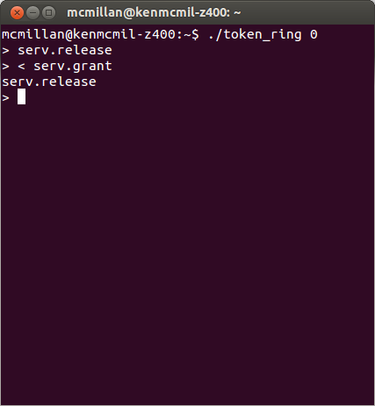
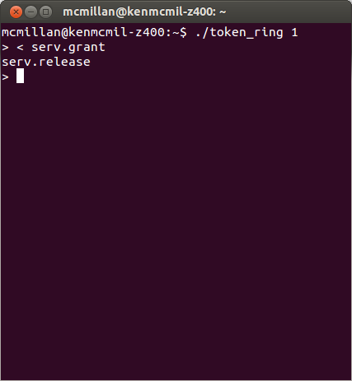
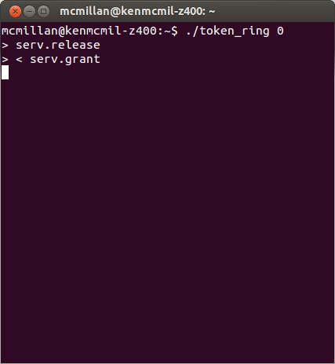
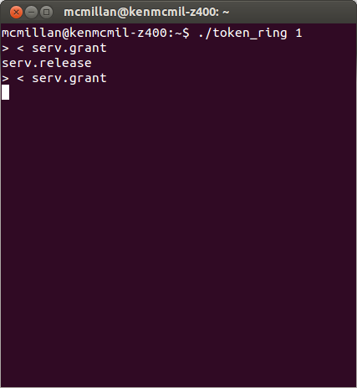
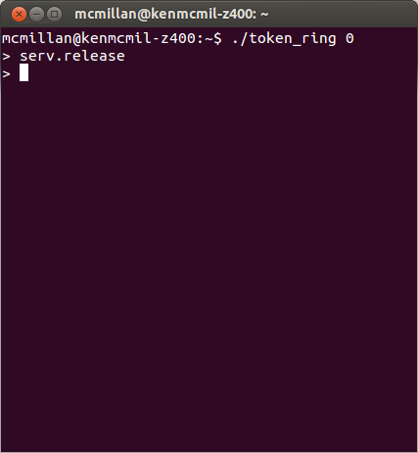
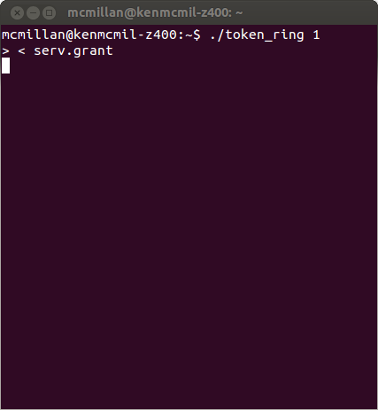
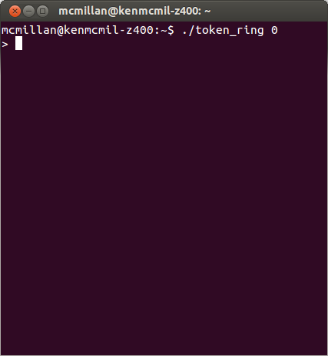
Running parallel processes
Compilation of extracted process, without specs
$ ivyc token_ring.ivy

Slide 47
Modularity for Decidability
How to make use of Ivy’s features to get the most out of Z3

Slide 48
Strategy
Because decidable fragments are not closed under conjunction, our primary strategy is to separate concerns
Modular reasoning
Use isolates to hide theories or function symbols
FO=
$$f:s→t$$
program
Protocol
QFLIA
$$f:s\text{⇸}t$$
$$g:t→s$$
ADT
Abstract model

Slide 49
ADT example
isolate index = {
type this
action next(x:index) returns (x:index)
specification {
property X:index < Y $∧$ Y < Z $→$ X < Z # transitivity
property $¬$(X < Y $∧$ Y < X) # antisymmetry
property X < Y $∨$ X = Y $∨$ Y < X # totality
after next {
ensure old x < x $∧¬∃y.(\text{old} \text{x}<y<\text{x})$
}
}
implementation {
interpret index $→$ int
implement next {
x := x + 1
}
}
Introduces no skolem functions: why?
Implementation provable in decidable fragment (QFLIA)
As in math, don’t use more hypotheses than you need! Especially, never use an integer when a more abstract type will do.

Slide 50
Example: array reverse copy
action rev_copy(a:arr) returns(b:arr) = {
var idx : index := 0;
b := b.resize(a.end,0);
while idx < a.end
{
b[a.end - idx – 1] := a[idx];
idx := idx + 1;
};
}
invariant a.end = b.end $∧$ idx $≤$ a.end
Inductive
invariant
invariant $∀$ J. J < idx $→$b[a.end-J-1] = a[J]
ensure b.end = a.end;
Specification
ensure $∀$J. J < a.end -> b[a.end-J-1] = a[J]
2
add a mistake
Result of checking verification conditions with Z3: divergence or “unknown”
Reason: undecidability leads to unpredictability, instability, opacity

Slide 51
Ivy fragment checker
Ivy produces the following error message:
Error: the verification condition is not in fragment FAU
An interpreted symbol is applied to a universally quantified variable:
line 49: a.length – J
line 49: the quantified variable is J
Ivy identifies sub-formula causing problem
Because of the fragment checker, Ivy fails transparently.
Strategy: To fix this problem we can hide the arithmetic in a relational abstraction.

Slide 52
Relation abstraction of “reversal”
module rev(t) = {
relation r(U:t,X:t,Y:t)
action app(u:t,x:t) returns (y:t)
} with t
X and Y are reversed positions in array
of length U.
Procedure computes the reverse of
position x.
specification {
property r(U,X,Y) & r(U,X,Y1) -> Y = Y1
property X < Y & Y < U & r(U,X,X1) & r(U,Y,Y1) -> Y1 < X1
property X < U & r(U,X,X1) -> X1 < U
after app {
ensure r(u,x,y)
}
}
Partial function X $→$Y
Order-reversing
Computes y correctly
Into [0,U)
implementation {
definition r(U,X,Y) = (Y = U - X - 1)
implement app {
y := u - x - 1;
}
}
Arithmetic is hidden

Slide 53
Array reversal with abstraction
procedure rev_copy(a:arr) returns(b:arr) {
var idx : index := 0;
b.resize(a.end,0);
while idx < a.end
{
b[rev.app(a.end,idx)] := a[idx];
idx := idx.next;
};
}
invariant a.end = b.end $∧$ idx $≤$ a.length
Inductive
invariant
invariant $∀$ J,K. J < idx $∧$ rev.r(a.end,J,K) -> b[K] = a[J]
Delegate arithmetic to abstraction
ensure b.end = a.end;
Specification
ensure $∀$ J,K. J < a.end $∧$ rev.r(a.end,J,K) -> b[K] = a[J]
Problem: quantifier mixed with interpreted arithmetic
Solution: separate the quantifier and arithmetic using modularity
Notice that the ‘rev’ module is generic and reusable

Slide 54
Theory hiding
A theory may take us outside the decidable fragment
Solution: hide the theory in a module
Export from the module just the properties you need
However, theory reasoning is not the only problem. Function cycles also often cause Ivy’s fragment checker to complain. These can be caused by function symbols in the state, or by Skolem functions in properties.
Often this problem can be solved by making an abstract model that uses relations rather than functions.

Slide 55
Parameterized toy leader election
N processes choose a leader
Process may request vote by broadcast
Processes vote for a requester
Process with majority of votes is leader
leader 0
req
1
0
req
Prove: at most one leader
req
req
vote 0
vote 0
leader 0
2
Example due to Oded Padon

Slide 56
Decidability issues
To prove this protocol, we need an inductive invariant.
This invariant will have quantifiers over pid’s.
The protocol state will use this vocabulary
$\text{sent} :\text{msg}→\text{bool}$
$\text{voted} :\text{pid}→\text{bool}$
$\text{votes} :\text{pid}→\text{set}(\text{pid})$
Problem: cardinality reasoning
if $\left|\text{votes}\left(p\right)\right|>\frac{\left|\text{all}\right|}{2}$ then send leader($p$)
cardinality + arithmetic + UF + quantifiers = undecidable!
Solution: hide cardinality in an abstract data type

Slide 57
An ADT for pid sets
module set(pid) = {
var member: pid $×$ set $→$ bool
var majority: set $→$ bool
action empty returns(s:set)
action add(s:set,e:pid) returns (s:set)
specification {
after empty { ensure $∀p. ¬\text{member}(p,\text{s})$ }
after add { ensure $∀p.\text{member}\left(p,\text{s}\right)↔(\text{member}\left(p,\text{old} \text{s}\right)∨p=e)$ }
}
private {
property [maj] $∀s,t. \text{majority}\left(s\right)∧\text{majority}\left(t\right)$
$→∃p. \text{member}\left(p,s\right)∧\text{member}(p,t)$
}
}
Notice the specification is in $FO_{=}. We have hidden the ca$rdinality and arithmetic.
The key is to recognize that the protocol only needs property maj.
The implementation of this module can be verified in the FAU fragment.

Slide 58
Function cycles
We still have a problem:
Our protocol state has a function $\text{votes} :\text{pid}→\text{set}$
Skolemizing maj gives a function set $→$ set $→$ pid
$$∀s,t. \text{majority}\left(s\right)∧\text{majority}\left(t\right)$$
$→∃p. \text{member}\left(p,s\right)∧\text{member}(p,t)$
This creates a function cycle, meaning the VC’s proving our protocol invariant are unstratified, hence outside Z3’s decidable range.
Solution:
Create an abstract protocol model that doesn’t use the function votes.
Prove an invariant using maj, then use this as a lemma to prove the concrete protocol implementation.

Slide 59
Abstract protocol model
isolate protocol = {
var voted : pid $×$pid $→$bool
var isleader : pid $→$bool
var quorum : set
after init {
voted(X,Y) := false;
isleader(X) := false
}
voted is a relation.
specification {
action vote(v : pid, n : pid) = {
require $∀N. ¬\text{voted}(\text{v},N)$
voted(v,n) := true
}
ghost action
action make_leader(n : pid, s : set) = {
require $majority(s)$
require $∀N. \text{member}\left(N,\text{s}\right)→\text{voted}(N,\text{n})$
isleader(n) := true
quorum := s
}
invariant isleader(X) $∧$ isleader(Y) $→$X=Y
}
voted is a partial function
leader has a quorum
} with set, set.maj
auxiliary invariants:
Provable in stratified $FO_{=}$!

Slide 60
Concrete protocol
Uses real network
Decorated with ghost calls to abstract model
Uses abstract model invariant in proof
action handle_req(self:pid, n:pid) = {
if $¬\text{voted}\left(\text{self}\right)$ {
$\text{voted}\left(\text{self}\right)$ := true
call send_vote(self,n)
call protocol.vote(self,n)
}
}
Note call to abstract model
must satisfy precondition

Slide 61
Receiving a vote
action handle_vote(self : node, src : node, vote : node) {
if vote = self {
voters(self) := voters(self).add(src);
if set.majority(voters(self)) {
call send_leader(self);
call protocol.make_leader(self, voters(self))
}
}
}
voters(self) must be a quorum for self!
The concrete specification looks like this:
specification {
function is_leader(N) = $∃$M. net.sent(N,M) $∧$ M.is_leader
invariant [safe] is_leader(N1) $∧$is_leader(N2) $→$N1=N2
}

Slide 62
Implementation invariant
The implementation invariant relates the abstract protocol and implementation states
private {
invariant net.sent(M,N) $∧$ M.is_vote $→$protocol.voted(M.src, M.vote)
invariant set.member(N1 ,voters(N2)) $→$ protocol.voted(N1,N2)
invariant net.sent(M,N) $∧$ M.is_leader $→$ protocol.isleader(M.src)
invariant protocol.voted(N1,N2) $→$ voted(N1)
}
In place of property maj, we use the one leader invariant of the abstract model.
Our invariant relates protocol.isleader to the network contents, allowing us to prove the implementation has at most one leader, without function cycles.
Now we can compile and run our concrete protocol, with the abstract protocol sliced.

Slide 63
Tactics
To reduce our proof to decidable VC’s we used two main tactics:
Hide theory reasoning inside an ADT
Theories (esp. arithmetic) tend to break decidability
Think about what properties/operations you need over a type
Put these in the specification of the type
Hide the theory in the implementation
Prove key lemmas in an abstract model
Use relations instead of functions for stratification
Use the lemmas in the concrete protocol
Allows hiding inconvenient properties or functions
Implementation invariant relates concrete/abstract state
Abstractions also reduce proof complexity
It helps a lot to plan an order of sorts in advance, to minimize function cycles.

Slide 64
Paxos variants and Raft
Distributed consensus protocols
Widely used in cloud services to implement replicated state machines
Have a leader election phase similar to our toy example
Use same strategy as toy protocol
Same ADT for sets with majority predicate
Abstract protocol model with relational state
Prove consistency of this model as a lemma
Use consistency of abstract model to prove implementation consistency
Inductive invariant relates abstract/concrete state

Slide 65
Implementation invariant
conjecture vsp.started(E,self) <-> E <= current_epoch
conjecture vsp.proposal(E,I,V) & leader_of(self,E) -> E < current_epoch
| E = current_epoch & I < proposal_inst
conjecture vsp.vote(E,self,I,V) -> E <= current_epoch
conjecture vsp.transferral(E,self,I,V) -> E < current_epoch | E = current_epoch & I < proposal_inst
conjecture shim.sent(M,D) & msg.m_kind(M) = msg_kind.propose
-> vsp.proposal(msg.m_epoch(M),msg.m_inst(M),msg.m_value(M))
conjecture shim.sent(M,D) & msg.m_kind(M) = msg_kind.do_vote
-> vsp.vote(msg.m_epoch(M),msg.m_node(M),msg.m_inst(M),msg.m_value(M))
conjecture nodeset.member(N,voters) -> vsp.vote(current_epoch,N,current_inst,current_value)
conjecture (E > current_epoch | E = current_epoch & ~wedged) -> ~vsp.wedged(E,self)
conjecture shim.sent(M,D) & msg.m_kind(M) = msg_kind.wedge
-> vsp.wedge_msg(msg.m_epoch(M),msg.m_stake(M))
conjecture shim.sent(M,D) & msg.m_kind(M) = msg_kind.wedge
-> msg.m_stake(M) > 0
conjecture S >= current_stake -> ~vsp.left_stake(current_epoch,self,S)
conjecture E > current_epoch -> ~vsp.left_stake(E,self,S)
conjecture shim.sent(M,D) & msg.m_kind(M) = msg_kind.wedge_ack
-> vsp.joined_stake(msg.m_epoch(M),msg.m_node(M),msg.m_stake(M))
conjecture vsp.joined_stake(current_epoch,self,S) -> current_stake >= S
conjecture E > current_epoch -> ~vsp.joined_stake(E,self,S)
conjecture shim.sent(M,D) & msg.m_kind(M) = msg_kind.wedge_ack
& msg.m_maxs(M) < S & S < msg.m_stake(M)
-> ~vsp.accepted_msg(msg.m_epoch(M),msg.m_node(M),S,C)
conjecture nodeset.member(N,ackers) -> vsp.joined_stake(current_epoch,N,current_stake)
conjecture wedged -> current_stake > 0
conjecture shim.sent(M,D) & msg.m_kind(M) = msg_kind.accepted
-> vsp.accepted_msg(msg.m_epoch(M),msg.m_node(M),msg.m_stake(M),msg.m_config(M))
& msg.m_stake(M) > 0
conjecture nodeset.member(N,ackers) & ackers_maxs < S & S < current_stake
-> ~vsp.accepted_msg(current_epoch,N,S,C) & vsp.joined_stake(current_epoch,N,S)
conjecture accepted_stake <= current_stake
conjecture accepted_stake < S
-> ~vsp.accepted_msg(current_epoch,self,S,C)
conjecture E > current_epoch -> ~vsp.accepted_msg(E,self,S,C)
conjecture accepted_stake > 0
-> vsp.accepted_msg(current_epoch,self,accepted_stake,accepted_history)
conjecture shim.sent(M,D) & msg.m_kind(M) = msg_kind.wedge_ack & msg.m_maxs(M) > 0
-> vsp.accepted_msg(msg.m_epoch(M),msg.m_node(M),
msg.m_maxs(M),msg.m_config(M))
& msg.m_maxs(M) < msg.m_stake(M)
conjecture best_acker.present & best_acker.is(N) -> nodeset.member(N,ackers)
conjecture best_acker.present & best_acker.is(N) & ackers_maxs > 0
-> vsp.accepted_msg(current_epoch,N,ackers_maxs,ackers_config)
& ackers_maxs < current_stake
conjecture any_vote(current_epoch,self,I,V) <-> val_at(history,I,V)
conjecture vsp.vote(E,N,I,V) -> vsp.proposal(E,I,V)
conjecture vsp.proposal(E,I,V) & vsp.proposal(E,I,W) -> V = W
conjecture shim.sent(M,D) & msg.m_kind(M) = msg_kind.wedge_ack
& msg.m_node(M) = self & msg.m_maxs(M) = 0
-> (any_vote(msg.m_epoch(M),self,I,V) <-> val_at(msg.m_config(M),I,V))
& (msg.m_epoch(M) = current_epoch & wedged | msg.m_epoch(M) < current_epoch)
conjecture ackers_maxs = 0 & nodeset.member(M,ackers)
& any_vote(current_epoch,M,I,V) -> val_at(ackers_config,I,V)
conjecture best_acker.present & best_acker.is(N) & ackers_maxs = 0
-> (any_vote(current_epoch,N,I,V) <-> val_at(ackers_config,I,V))
conjecture shim.sent(M,D) & msg.m_kind(M) = msg_kind.accept
-> vsp.accept_msg(msg.m_epoch(M),msg.m_stake(M),msg.m_config(M))
conjecture shim.sent(M,D) & msg.m_kind(M) = msg_kind.accept -> msg.m_stake(M) > 0
conjecture nodeset.member(N,acceptors)
-> vsp.accepted_msg(current_epoch,N,current_stake,acceptors_config)
conjecture spec.decided(I,V) -> vsp.any_decision(I,V)

Slide 66
Comparisons
Verdi (Coq)
Ironfleet (Dafny/Z3)
Ivy/Z3
SLOC
proof
ratio
SLOC
proof
ratio
SLOC
proof
ratio
Raft
530
50000
94
560
200
0.36
Multi-Paxos
3000
12000
4
330
266
0.8
check: 6hr in cloud
manual tweaking required
Instability a significant challenge
check: few minutes on laptop
reliable, fully automated
reliable counterexamples
highly stable
Using decidable fragments does not cost in proof complexity.
We achieve predictability, stability and transparency without increasing the overall proof complexity.

Slide 67
Other Ivy capabilities
Various capabilities of Ivy not discussed here:
Bounded model checking
Automated specification-based testing
Invariant inference using finite-state model checking
Verification of liveness properties
Interactive theorem proving
Ivy lets you do any manual reasoning you want to, regardless of decidability.
Sometimes the best way to handle a property with a quantifier alternation is to use Ivy’s theorem prover to manually ground it.

Slide 68
Conclusion
To achieve an order-of-magnitude improvement in verification productivity with automation, we must make careful choices about the division of labor between human and machine.
Because proof is iterative, we must use automation in a way that is predictable, stable and transparent.
Plan the development so that proof obligations reduce easily to sub-goals that the automation can handle reliably.
Tools must provide actionable feedback when a proof goal can’t be handled (must fail transparently).
Ivy is an instantiation of these ideas, based on Z3’s decidable fragment. It provides tools and strategies for reducing proofs to sub-goals that Z3 can handle predictably, reliably and transparently.

Slide 69
Resources
The Ivy website: http://microsoft.github.io/ivy/
Overview paper on Ivy:
Kenneth L. McMillan, Oded Padon: Deductive Verification in Decidable Fragments with Ivy.SAS 2018: 43-55
Paper on consensus protocol verification:
Marcelo Taube, Giuliano Losa, Kenneth L. McMillan, Oded Padon, Mooly Sagiv, Sharon Shoham, James R. Wilcox, Doug Woos: Modularity for decidability of deductive verification with applications to distributed systems. PLDI 2018: 662-677

